Slide 1
Incident Handling

Slide 2
Three Functions
Incident Reporting
Incident Analysis
Incident Response

Slide 3
Incident Reporting
Such functions enables a CERT to serve as a central point of contact for reporting problems
Allows all incidents reports and activity to be collected in one location
Here, Information can be reviewed and correlated across the organization
Information can then be used to determine patterns of intruders or activity

Slide 4
Incident Analysis Function
Recommendation of corresponding preventative strategies can be given
In-depth look at an incident report of the activity to determine the scope, priority and threat of the incident
Researching possible response and mitigation strategies.

Slide 5
Incident Response
It can take many forms
A CERT may send out recommendations for recovery, containment and prevention of systems
Network administrators at sites then performs the response steps themselves
CERT may also perform these steps themselves but only, when network administrators are unable to mitigate the problem
Share information and lessons learned with other team members

Slide 6
SANS Institute Recommendations
The SANS Institute is a private U.S. for-profit company founded in 1989.
Specializes in information security, cybersecurity training and selling certificates.
Topics available for training include cyber and network defenses, penetration testing, incident response, digital forensics, and audit.
According to them, There are six steps to handle an incident most effectively

Slide 7
Steps to handle an incident
Preparation
Identification
Containment
Eradication
Recovery
Learning Lesson

Slide 8
Preparation
Any Incident Response methodologies will emphasize on preparation
Not only establishing an incident response capability so that the organization is ready to respond to incidents
They should be able to prevent incidents by ensuring that systems, networks and applications are sufficiently secure

Slide 9
Preparation
Incident Handler Communications and Facilities
Contact Information
On-call information
Incident reporting mechanisms
Issue tracking system
Smartphones
War Room
Secure Storage Facility
Notes:
Contact information for team members and others within and outside the organization (primary and backup contacts), such as law enforcement and other incident response teams; information may include phone numbers, email addresses, public encryption keys (in accordance with the encryption software described below), and instructions for verifying the contact’s identity
 On-call information for other teams within the organization, including escalation information
 Incident reporting mechanisms, such as phone numbers, email addresses, online forms, and secure instant messaging systems that users can use to report suspected incidents; at least one mechanism should permit people to report incidents anonymously
 Issue tracking system for tracking incident information, status, etc.
 Smartphones to be carried by team members for off-hour support and onsite communications
 Encryption software to be used for communications among team members, within the organization and with external parties; for Federal agencies, software must use a FIPS-validated encryption algorithm20
 War room for central communication and coordination; if a permanent war room is not necessary or practical, the team should create a procedure for procuring a temporary war room when needed
 Secure storage facility for securing evidence and other sensitive materials

Slide 10
Preparation
Incident Analysis Hardware and Software
Digital Forensic Workstations and/or Backup devices
Laptops
Spare workstations, servers, network equipment
Blank removable media
Portable Printers
Packet sniffers and protocol analyzers
Removable media with trusted tools
Evidence gathering accessories
Notes:
Digital forensic workstations21 and/or backup devices to create disk images, preserve log files, and save other relevant incident data
 Laptops for activities such as analyzing data, sniffing packets, and writing reports
 Spare workstations, servers, and networking equipment, or the virtualized equivalents, which may be used for many purposes, such as restoring backups and trying out malware
 Blank removable media
 Portable printer to print copies of log files and other evidence from non-networked systems
 Packet sniffers and protocol analyzers to capture and analyze network traffic
 Digital forensic software to analyze disk images
 Removable media with trusted versions of programs to be used to gather evidence from systems
 Evidence gathering accessories, including hard-bound notebooks, digital cameras, audio recorders, chain of custody forms, evidence storage bags and tags, and evidence tape, to preserve evidence for possible legal actions

Slide 11
preparation
Incident Analysis Resources
Port lists
Documentations
Network diagrams and lists of critical assets
Current baselines
Cryptographic hashes of critical files
Incident Mitigation Software
Access to images of clean OS and applications
Notes:
Port lists, including commonly used ports and Trojan horse ports
 Documentation for OSs, applications, protocols, and intrusion detection and antivirus products
 Network diagrams and lists of critical assets, such as database servers
 Current baselines of expected network, system, and application activity
 Cryptographic hashes of critical files22 to speed incident analysis, verification, and eradication
Incident Mitigation Software:
 Access to images of clean OS and application installations for restoration and recovery purposes

Slide 12
Preparation
Preventing Incidents
Risk Assessments
Host Security
Network Security
Malware Prevention
User Awareness and Training
Notes:
Risk Assessments. Periodic risk assessments of systems and applications should determine what risks are posed by combinations of threats and vulnerabilities.25 This should include understanding the applicable threats, including organization-specific threats. Each risk should be prioritized, and the risks can be mitigated, transferred, or accepted until a reasonable overall level of risk is reached. Another benefit of conducting risk assessments regularly is that critical resources are identified, allowing staff to emphasize monitoring and response activities for those resources.26
 Host Security. All hosts should be hardened appropriately using standard configurations. In addition to keeping each host properly patched, hosts should be configured to follow the principle of least privilege—granting users only the privileges necessary for performing their authorized tasks. Hosts should have auditing enabled and should log significant security-related events. The security of hosts and their configurations should be continuously monitored.27 Many organizations use Security Content Automation Protocol (SCAP)28 expressed operating system and application configuration checklists to assist in securing hosts consistently and effectively.29
 Network Security. The network perimeter should be configured to deny all activity that is not expressly permitted. This includes securing all connection points, such as virtual private networks (VPNs) and dedicated connections to other organizations.
 Malware Prevention. Software to detect and stop malware should be deployed throughout the organization. Malware protection should be deployed at the host level (e.g., server and workstation operating systems), the application server level (e.g., email server, web proxies), and the application client level (e.g., email clients, instant messaging clients).30
 User Awareness and Training. Users should be made aware of policies and procedures regarding appropriate use of networks, systems, and applications. Applicable lessons learned from previous incidents should also be shared with users so they can see how their actions could affect the organization. Improving user awareness regarding incidents should reduce the frequency of incidents. IT staff should be trained so that they can maintain their networks, systems, and applications in accordance with the organization’s security standards.

Slide 13
Identification
Incidents can occur in countless ways
Hence it is impossible to develop step-by-step instructions to handle every incident
Organizations should be generally prepared to handle any incident but should focus on being prepared to handle incidents that use common attack vectors

Slide 14
Identification
Attack Vectors
External/Removable Media
Attrition
Web
Email
Impersonation
Improper Usage
Loss or Theft of Equipment
Other
Notes:
External/Removable Media: An attack executed from removable media or a peripheral device—for example, malicious code spreading onto a system from an infected USB flash drive.
 Attrition: An attack that employs brute force methods to compromise, degrade, or destroy systems, networks, or services (e.g., a DDoS intended to impair or deny access to a service or application; a brute force attack against an authentication mechanism, such as passwords, CAPTCHAS, or digital signatures).
 Web: An attack executed from a website or web-based application—for example, a cross-site scripting attack used to steal credentials or a redirect to a site that exploits a browser vulnerability and installs malware.
 Email: An attack executed via an email message or attachment—for example, exploit code disguised as an attached document or a link to a malicious website in the body of an email message.
 Impersonation: An attack involving replacement of something benign with something malicious—for example, spoofing, man in the middle attacks, rogue wireless access points, and SQL injection attacks all involve impersonation.
 Improper Usage: Any incident resulting from violation of an organization’s acceptable usage policies by an authorized user, excluding the above categories; for example, a user installs file sharing software, leading to the loss of sensitive data; or a user performs illegal activities on a system.
 Loss or Theft of Equipment: The loss or theft of a computing device or media used by the organization, such as a laptop, smartphone, or authentication token.
 Other: An attack that does not fit into any of the other categories.

Slide 15
Identification
Sources of Precursors and Indicators
Alerts
IDS & IPS
SIEMs
Antivirus
File integrity checking software
Third Party monitoring service

Slide 16
Identification
Sources of Precursors and Indicators
Logs
OS logs
Service Logs
Application Logs
Network Logs

Slide 17
Identification
Sources of Precursors and Indicators
Publicly Available Information
Information on new Vulnerabilities
People
People from within the organization
People from other organizations

Slide 18
Incident analysis
Incident detection and analysis is generally easy if all precursor or indicator are guaranteed to be accurate; however, that may not be the case sometimes.
User provided indicators such as a complain a server being unavailable can be incorrect.
IDS may produce false positive
Each indicators ideally should be evaluated to determine if it is a legitimate or not. But, depending on an organization, number of indicators may be thousands or millions a day.
Such scenarios makes incident analysis a difficult task

Slide 19
Incident analysis
Recommendations for performing initial analysis
Profile networks and systems
Understand normal behaviors
Create a log retention policy
Perform event correlation
Keep all host clocks synchronized
Notes:
Profile Networks and Systems. Profiling is measuring the characteristics of expected activity so that changes to it can be more easily identified. Examples of profiling are running file integrity checking software on hosts to derive checksums for critical files and monitoring network bandwidth usage to determine what the average and peak usage levels are on various days and times. In practice, it is difficult to detect incidents accurately using most profiling techniques; organizations should use profiling as one of several detection and analysis techniques.
 Understand Normal Behaviors. Incident response team members should study networks, systems, and applications to understand what their normal behavior is so that abnormal behavior can be recognized more easily. No incident handler will have a comprehensive knowledge of all behavior throughout the environment, but handlers should know which experts could fill in the gaps. One way to gain this knowledge is through reviewing log entries and security alerts. This may be tedious if filtering is not used to condense the logs to a reasonable size. As handlers become more familiar with the logs and alerts, they should be able to focus on unexplained entries, which are usually more important to investigate. Conducting frequent log reviews should keep the knowledge fresh, and the analyst should be able to notice trends and changes over time. The reviews also give the analyst an indication of the reliability of each source.
 Create a Log Retention Policy. Information regarding an incident may be recorded in several places, such as firewall, IDPS, and application logs. Creating and implementing a log retention policy that specifies how long log data should be maintained may be extremely helpful in analysis because older log entries may show reconnaissance activity or previous instances of similar attacks. Another reason for retaining logs is that incidents may not be discovered until days, weeks, or even months later. The length of time to maintain log data is dependent on several factors, including the organization’s data retention policies and the volume of data. See NIST SP 800-92, Guide to Computer Security Log Management for additional recommendations related to logging.34
 Perform Event Correlation. Evidence of an incident may be captured in several logs that each contain different types of data—a firewall log may have the source IP address that was used, whereas an application log may contain a username. A network IDPS may detect that an attack was launched against a particular host, but it may not know if the attack was successful. The analyst may need to examine the host’s logs to determine that information. Correlating events among multiple indicator sources can be invaluable in validating whether a particular incident occurred.
Keep All Host Clocks Synchronized. Protocols such as the Network Time Protocol (NTP) synchronize clocks among hosts.35 Event correlation will be more complicated if the devices reporting events have inconsistent clock settings. From an evidentiary standpoint, it is preferable to have consistent timestamps in logs—for example, to have three logs that show an attack occurred at 12:07:01 a.m., rather than logs that list the attack as occurring at 12:07:01, 12:10:35, and 11:07:06.

Slide 20
Incident analysis
Recommendations for performing initial analysis
Maintain and Use a Knowledge base of information
Use Internet search engines for research
Run Packet sniffers to collect additional data
Filter the data
Seek assistance from others
Notes:
Maintain and Use a Knowledge Base of Information. The knowledge base should include information that handlers need for referencing quickly during incident analysis. Although it is possible to build a knowledge base with a complex structure, a simple approach can be effective. Text documents, spreadsheets, and relatively simple databases provide effective, flexible, and searchable mechanisms for sharing data among team members. The knowledge base should also contain a variety of information, including explanations of the significance and validity of precursors and indicators, such as IDPS alerts, operating system log entries, and application error codes.
 Use Internet Search Engines for Research. Internet search engines can help analysts find information on unusual activity. For example, an analyst may see some unusual connection attempts targeting TCP port 22912. Performing a search on the terms “TCP,” “port,” and “22912” may return some hits that contain logs of similar activity or even an explanation of the significance of the port number. Note that separate workstations should be used for research to minimize the risk to the organization from conducting these searches.
 Run Packet Sniffers to Collect Additional Data. Sometimes the indicators do not record enough detail to permit the handler to understand what is occurring. If an incident is occurring over a network, the fastest way to collect the necessary data may be to have a packet sniffer capture network traffic. Configuring the sniffer to record traffic that matches specified criteria should keep the volume of data manageable and minimize the inadvertent capture of other information. Because of privacy concerns, some organizations may require incident handlers to request and receive permission before using packet sniffers.
 Filter the Data. There is simply not enough time to review and analyze all the indicators; at minimum the most suspicious activity should be investigated. One effective strategy is to filter out categories of indicators that tend to be insignificant. Another filtering strategy is to show only the categories of indicators that are of the highest significance; however, this approach carries substantial risk because new malicious activity may not fall into one of the chosen indicator categories.
 Seek Assistance from Others. Occasionally, the team will be unable to determine the full cause and nature of an incident. If the team lacks sufficient information to contain and eradicate the incident, then it should consult with internal resources (e.g., information security staff) and external resources (e.g., US-CERT, other CSIRTs, contractors with incident response expertise). It is important to accurately determine the cause of each incident so that it can be fully contained and the exploited vulnerabilities can be mitigated to prevent similar incidents from occurring.

Slide 21
Incident documentation
An IR team that suspects that an incident has occurred should immediately start recording all facts regarding the incident
A logbook is an effective and simple medium for this, but laptops, audio recorders and digital cameras can also serve this purpose.
It leads to more efficient, more systematic and less error-prone handling of the problem.
Every step taken from the time the incident was detected to its final resolution should be documented and timestamped and signed by the incident handlers.

Slide 22
Incident documentation
The issue tracking system should contain information on the following:
The current status of the incident
A summary of the incident
Indicators related to the incident
Other incidents related to this incident
Actions taken by all incident handlers on this incident
Chain of custody, [if applicable]

Slide 23
Incident documentation
The issue tracking system should contain information on the following:
Impact assessments related to the incident
Contact information for other involved parties (e.g. system owners, system administrators)
A list of evidence gathered during the incident investigation
Comments from incident handlers on each evidence
Next steps to be taken

Slide 24
Incident prioritization
It can be considered as the most critical decision point in the incident handling process
Incidents should NEVER be handled on first-come first-served basis
Incident should always be prioritized on the relevant factors

Slide 25
Incident Prioritization
The relevant factors are as follow:
Functional Impact of the Incident
Information Impact of the Incident
Recoverability from the Incident

Slide 26
Functional impact of the incident
Incidents targeting IT systems typically impact the business functionality that those system provide
It can leave negative impact to the users of those systems
Handlers should consider how the incident will impact the existing functionality of the affected systems.

Slide 27
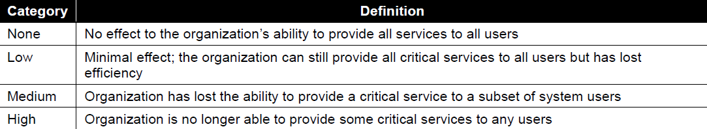
Functional impact of the incident

Slide 28
Information impact of incident
Incidents may affect the confidentiality, integrity and availability of the organization’s information.
For example, A malicious agent may exfiltrate sensitive information.
Incident handlers should consider how this information exfiltration will impact the organization’s overall mission.

Slide 29
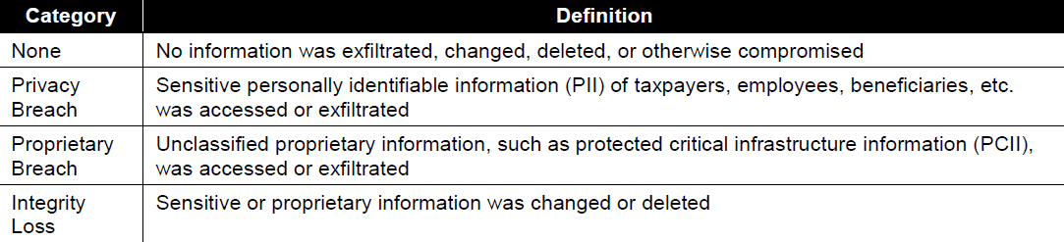
Information impact of incident

Slide 30
Recoverability from the incident
The size of the incident and the type of resources it affects will determine the amount of time and resources that must be spent on recovering from that incident.
In fact, In some instances it is never possible to recover from an incident
Notes:
The size of the incident and the type of resources it affects will determine the amount of time and resources that must be spent on recovering from that incident. In some instances it is not possible to recover from an incident (e.g., if the confidentiality of sensitive information has been compromised) and it would not make sense to spend limited resources on an elongated incident handling cycle, unless that effort was directed at ensuring that a similar incident did not occur in the future. In other cases, an incident may require far more resources to handle than what an organization has available. Incident handlers should consider the effort necessary to actually recover from an incident and carefully weigh that against the value the recovery effort will create and any requirements related to incident handling.

Slide 31
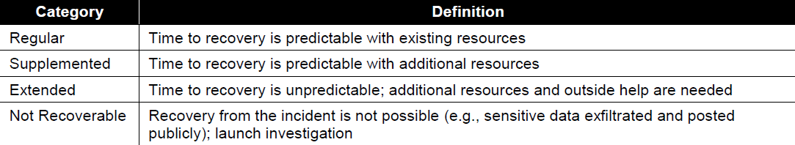
Recoverability from the incident

Slide 32
Incident notification
After an incident is analyzed and prioritized, the team needs to notify the appropriate individuals so that all who need to be involved will play their roles.
Incident response policies should include provisions concerning incident reporting and what must be reported to whom and what times.
During incident handling, the team may need to provide status updates to certain parties.
The team should plan and prepare several communication methods

Slide 33
Incident notification
CIO | Head of Information Security
Local Information Security Officer | Other IR Teams within the organization
External IRT | System Owner
HR (for case involving employees) | Public affairs (for incidents that may generate publicity)
Legal department (for incident with potential legal ramifications) | India-CERT
Law Enforcement (If appropriate)

Slide 34
Incident Notification
Possible Communication Methods Include
Email
Website (Internal, External, Portal)
Telephone calls
In person (e.g. Daily briefings)
Voice mailbox (Set up a separate voice mailbox for incident updates)
Paper ( e.g., Post notices on bulletin boards and doors)

Slide 35
Containment
Important to decrease damage
It provides time for developing a tailored remediation strategy
Essential part of containment is decision-making
Containment strategies very based on the type of incident

Slide 36
containment
Criteria for determining the appropriate strategy include:
Potential damage to and theft of resources
Need for evidence preservation
Service availability
Time and resources needed to implement the strategy
Effectiveness of the strategy
Duration of the solution

Slide 37
Containment
Some organizations redirect the attacker to a sandbox so that they can monitor the attacker’s activity, to gather additional evidence.
If an organization knows that a system has been compromised and allows the compromise to continue, it may be liable if the attacker uses the compromised system to attack other devices
The delayed containment is dangerous because an attacker could escalate unauthorized access or compromise other system.
Some attacks may cause additional damage when they are contained

Slide 38
Evidence Gathering and handling
The primary reason for gathering evidence is to resolve the incident and also to use it for legal proceedings.
Important to clearly document how all evidence ,including compromised systems, has been preserved.
Evidence should be collected according to procedures that meet all applicable laws and regulations that have been developed from previous discussions with legal staff and appropriate law enforcement agencies

Slide 39
Evidence Gathering and handling
Detailed log should be kept for all evidence, including the following:
Identifying information (location, serial number, hostname, MAC address, IP Address)
Name, title and phone number of each individual who collected or handled the evidence during the investigation
Time and date of each occurrence of evidence handling
Locations where the evidence was stored.

Slide 40
Evidence Gathering and handling
Collecting evidence from computing resources presents some challenges
It is desirable to acquire evidence from a system of interest as soon as one suspects that an incident may have occurred.
Many incidents cause a dynamic chain of events hence it is recommended to take initial system image as soon as you find the system of interest.
From evidentiary standpoint, it is much better to get a snapshot of the system before incident handler starts investigation.

Slide 41
Identifying the attacking hosts
During incident handling, system owners sometimes want to or need to identify the attacking host
This may sound important but Incident handlers should stay focused on containment, eradication and recovery.
Identifying an attacking host can be time consuming process that can prevent a team from achieving its primary goal

Slide 42
Identifying the attacking hosts
Following items describe the most commonly performed activities for attacking host identification:
Validating the attacking host’s IP Address
Researching the attacking host through search engines
Using Incident Databases
Monitoring Possible attacker communication channels
Notes:
Validating the Attacking Host’s IP Address. New incident handlers often focus on the attacking host’s IP address. The handler may attempt to validate that the address was not spoofed by verifying connectivity to it; however, this simply indicates that a host at that address does or does not respond to the requests. A failure to respond does not mean the address is not real—for example, a host may be configured to ignore pings and traceroutes. Also, the attacker may have received a dynamic address that has already been reassigned to someone else.
 Researching the Attacking Host through Search Engines. Performing an Internet search using the apparent source IP address of an attack may lead to more information on the attack—for example, a mailing list message regarding a similar attack.
 Using Incident Databases. Several groups collect and consolidate incident data from various organizations into incident databases. This information sharing may take place in many forms, such as trackers and real-time blacklists. The organization can also check its own knowledge base or issue tracking system for related activity.
 Monitoring Possible Attacker Communication Channels. Incident handlers can monitor communication channels that may be used by an attacking host. For example, many bots use IRC as their primary means of communication. Also, attackers may congregate on certain IRC channels to brag about their compromises and share information. However, incident handlers should treat any such information that they acquire only as a potential lead, not as fact.

Slide 43
Eradication
After an incident has been contained, Eradication may be necessary to eliminate components of the incident
Removing malware, disabling breached user accounts as well as identifying and mitigating all vulnerabilities that were exploited.
During eradication, it is important to identify all effected hosts within the organization so that they can be remediated.
For some incidents, eradication is either not necessary or is performed during recovery.

Slide 44
Recovery
Administrators would generally restore systems to normal operation
Administrators also confirm that the systems are functioning normally
It involve actions such as
Restoring systems from clean backups
Rebuilding systems from scratch
Replacing compromised files with clean versions
Installing patches
Changing passwords
Tightening network perimeter security

Slide 45
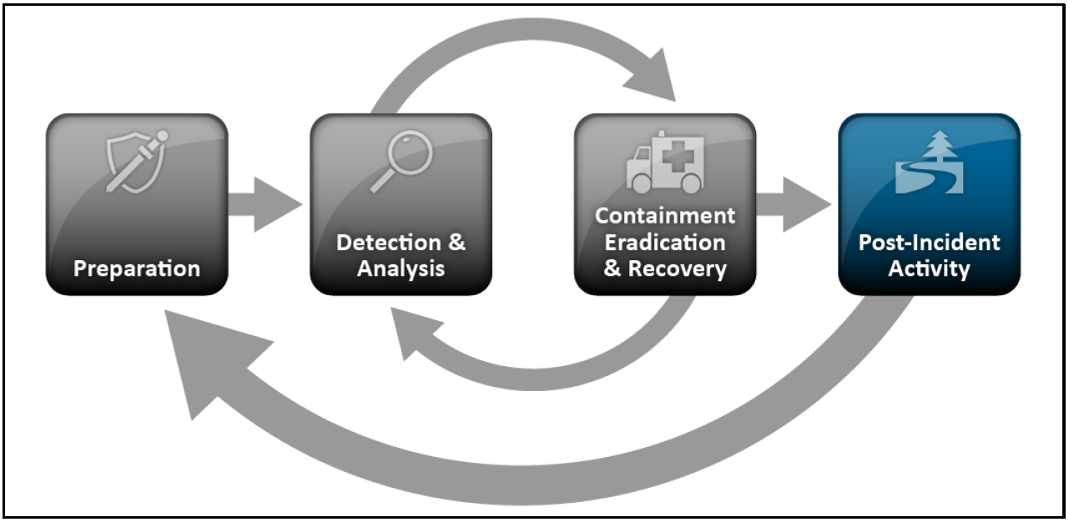
Post incident activity

Slide 46
Post incident activity
It mainly includes
Lessons learned
Using Collected Incident Data
Evidence Retention

Slide 47
Lessons Learned
One of the most important parts of incident response is also the most often omitted: learning and improving
Each incident response team should evolve to reflect new threats, improved technology and lessons learned
Organizations generally call a “lessons learned” meeting with all involved parties after a major incident.
It’s extremely helpful in improving security measures and the incident handling process itself.

Slide 48
Lessons Learned
Questions to be answered in such meetings include:
Exactly what happened, and at what times?
How well did staff and management perform in dealing with the incident? Were the documented procedures followed? Were they adequate?
What information was needed sooner?
Were any steps or actions taken that might have inhibited the recovery?

Slide 49
Lessons Learned
Questions to be answered in such meetings include:
What would the staff and management do differently the next time a similar incident occurs?
How could information sharing with other organizations have been improved?
What corrective actions can prevent similar incidents in the future?
What precursors or indicators should be watched for in the future to detect similar incidents?
What additional tools or resources are needed to detect, analyze, and mitigate future incidents?

Slide 50
Using Collected incident data
Lessons learned activities should produce a set of objective and subjective data regarding each incident.
Over the time, The collected incident data should be useful in several capacities.
If incident data is collected and stored properly, it should provide several measures of the success of the incident response team.
Incident data can also be collected to determine if a change to incident response capabilities causes a corresponding change in the team’s performance

Slide 51
Using Collected incident data
Possible Metrics for incident-related data include:
Number of incidents handled
Time per incident
Total amount of labor spent working on the incident
Elapsed time from the beginning of the incident to each stage of of incident handling
How long it took the incident response team to respond to the initial report of the incident
How long it took to report the incident to management and if necessary, appropriate external entities like Ind-Cert

Slide 52
Using Collected incident data
Possible Metrics for incident-related data include:
Objective Assessment of Each incident
Reviewing logs, forms, reports and other incident related documentation
Identifying which precursors and indicators of the incident were recorded to determine how effectively the incident was logged
Determining if the incident caused damage before it was detected
Determining if the actual cause of the incident was identified

Slide 53
Using Collected incident data
Possible Metrics for incident-related data include:
Objective Assessment of Each incident
Determining if the incident is recurrence of a previous incident
Calculating the estimated monetary damage
Measuring the difference between the initial impact assessment and final impact assessment
Identifying which measures, if any, could have prevented the incident

Slide 54
Using Collected incident data
Possible Metrics for incident-related data include:
Subjective Assessment of Each Incident
Team members assessing their own performance as well as that of other team members and of the entire team
Input from the owner of the resource that was attacked
To determine if the owner thinks the incident was handled efficiently and if the outcome was satisfactory

Slide 55
Evidence Retention
Organization should establish policy for how long evidence from an incident should be retained
Most organizations choose to retain all evidence for months and years after the incident ends
Following factors should be considered during the policy creation:
Prosecution
Data Retention
Cost
Notes:
 Prosecution. If it is possible that the attacker will be prosecuted, evidence may need to be retained until all legal actions have been completed. In some cases, this may take several years. Furthermore, evidence that seems insignificant now may become more important in the future. For example, if an attacker is able to use knowledge gathered in one attack to perform a more severe attack later, evidence from the first attack may be key to explaining how the second attack was accomplished.
 Data Retention. Most organizations have data retention policies that state how long certain types of data may be kept. For example, an organization may state that email messages should be retained for only 180 days. If a disk image contains thousands of emails, the organization may not want the image to be kept for more than 180 days unless it is absolutely necessary. As discussed in Section 3.4.2, General Records Schedule (GRS) 24 specifies that incident handling records should be kept for three years.
Cost. Original hardware (e.g., hard drives, compromised systems) that is stored as evidence, as well as hard drives and removable media that are used to hold disk images, are generally individually inexpensive. However, if an organization stores many such components for years, the cost can be substantial. The organization also must retain functional computers that can use the stored hardware and media

Slide 56
Incident Response Team Members Roles
For incident management to be successful, it is essential to carefully consider the roles within a CERT(Computer Emergency Response Team) and to tailor these to your specific mission, constituency and environment.
A CERT can be a virtual team with no formal members and with tasks distributed between different employees in various company departments such as the network operations centre, internal IT security team, legal department, PR department, help desk, etc.
It can also be a department in a company’s organizational structure, with several core members but also with some members from different departments, who work part-time or only on a specific task. it can also be an organisation or department with only full-time members.

Slide 57
Incident Response Team Member Roles
The mandatory Roles are:
Duty Officer
Triage Officer
Incident handler
Incident Manager

Slide 58
Duty Officer
A duty officer has to take care of all in-coming requests as well as carry out periodic or ad hoc activities dedicated to this role.

Slide 59
Triage Officer
The triage officer has to deal with all incidents that are reported to or by the team.
He needs to decide whether it is an incident that is to be handled by the team, when to handle it and who is going to be the incident handler according to the triage process

Slide 60
Incident Handler
The incident handler is a crucial role in the incident handling team.
He deals with the incidents analyzing data, creating workarounds, resolving the incident and communicating clearly about the progress he has made to his incident manager and to and with the appropriate constituent(s).

Slide 61
Incident Manager
The incident manager is responsible for the coordination of all incident handling activities.
He represents the incident handling team outside his team

Slide 62
Incident Response Team Structure
Possible structures for an incident response team include the following:
Central Incident Response Team
Distributed Incident Response Team
Coordinating Team
Employees
Partially Outsourced
Fully Outsourced

Slide 63
Central Incident response Team
A single incident response team handles incidents throughout the organization.
This model is effective for small organizations and for organizations with minimal geographic diversity in terms of computing resources.

Slide 64
Distributed Incident Response Team
The organization has multiple incident response teams, each responsible for a particular logical or physical segment of the organization.
This model is effective for large organizations (e.g., one team per division) and for organizations with major computing resources at distant locations (e.g., one team per geographic region, one team per major facility).

Slide 65
Coordinating Team
An incident response team provides advice to other teams without having authority over those teams—for example, a department wide team may assist individual agencies’ teams.

Slide 66
Employees
The organization performs all of its incident response work, with limited technical and administrative support from contractors.

Slide 67
Partially Outsourced
The organization outsources portions of its incident response work.

Slide 68
Fully Outsourced
The organization completely outsources its incident response work, typically to an onsite contractor.
This model is most likely to be used when the organization needs a full-time, onsite incident response team but does not have enough available, qualified employees.

